Slide 1


BACK TO BASKETBALL…
and BETTER
Webinar for European National Federations
Thursday, 7th September 2021, 18.00-19.30 CET

Slide 2
SPEAKERS

Slide 3

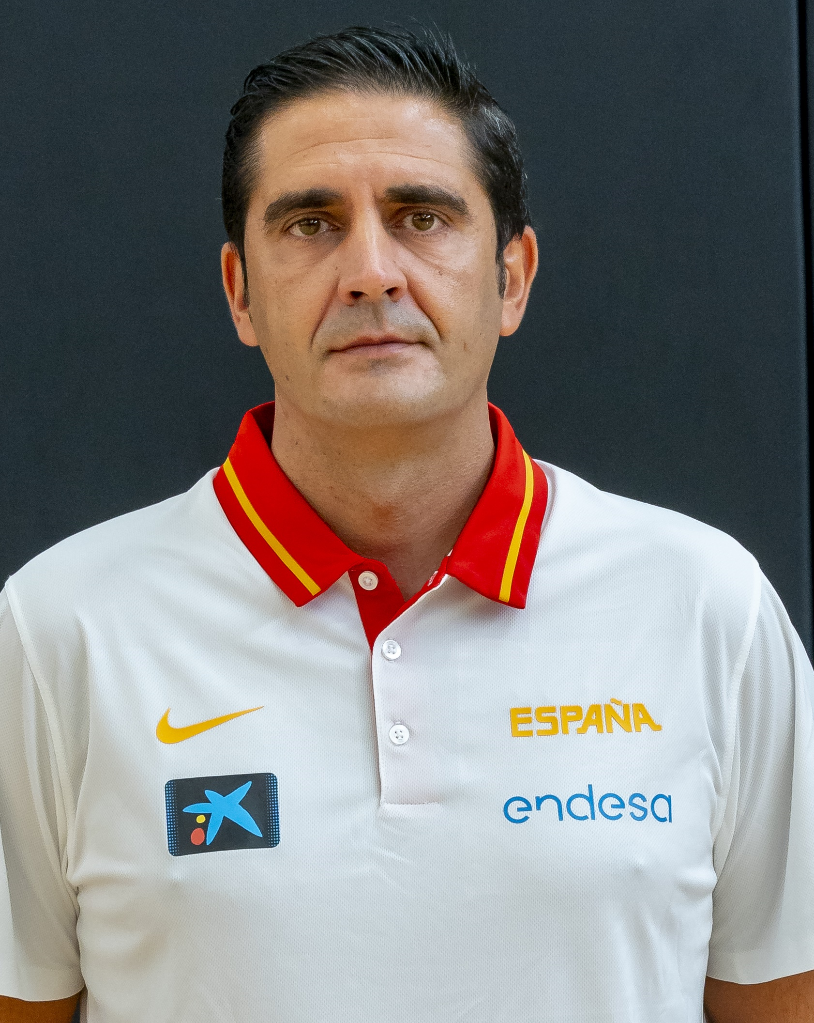
processes of monitoring and detecting future talents from minibasket categories throughout The formative years
Basketball coach since 1991 from minibasket categories to national senior category. Senior Basketball Coach since 1999.
Coach at Real Madrid CF (Infantil, Cadet, Junior Senior B) from 1997 to 2004.
Coach at B. Fuenlabrada (senior B, junior, cadet) from 2006 to 2009.
Coach for the Autonomous Community of Madrid "FBM" (Infant and Cadet) from 2009 to 2016.
Coach for the Spanish Basketball Federation "FEB" (U14 and U15) from 2009 to 2014. Participation in 3 European U16 Championships with the 1999, 2000 and 2001 generations (2015 to 2017).
Responsible for the categories U12 to U16 for the Spanish Basketball Federation "FEB" from 2018 to today.
In this session David Soria will share his experience in the processes of monitoring and detecting future talents from minibasket categories throughout the formative years.
David Soria Vaillo
Responsible for categories U12 to U16
FEB (Spanish Basketball Federation)

Slide 4
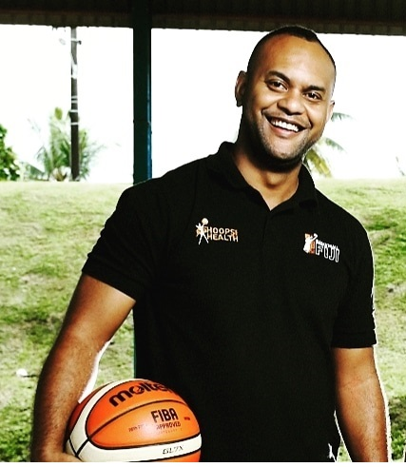
Basketball For Good program in Fiji
Passionate about basketball, Lai first joined Basketball Fiji as a volunteer in 2006, rising to the position of National Basketball Development Officer from 2009 to 2014, before stepping into the inaugural role of Chief Operating Officer in 2014, a responsibility he holds to date. Under Basketball Fiji's Basketball for Good program, Hoops for Health and other community and school outreach initiatives, Lai has witnessed national participation in the sport of basketball grow from 1,000 to 47,890 participants and counting over these years.
In this session, Lai will share how FIBA's Basketball For Good program has helped promote the sport of basketball and influenced positive social change in schools and within communities across Fiji.
Lai Puamau
Chief Operating Officer
Basketball Fiji

Slide 5


